Slide 1
Riskful play
Apole
Freinet Context - Brugge

Slide 2
schedule
1 Brainstorm in Brno: soapbox race
2 Bringing it to colleagues from bovenbouw (grades 4-6): collaboration L4 - L6
3 We made mixed groups and informed the kids, they needed to make a plan and make a list with stuff they needed. And decide who would bring what.
4 “Make-days” 1 en 2: a lot of enthusiasm, but no plans or material

Slide 3
5 Back to the drawing table as teachers, and then as kids. Brainstorms individuals and then ‘speed dating’
6 “Make-days” 3 - 5: better in some groups. They brought materials, sticked to the plan and re-evaluated when it was not working. But some groups remained with nothing. A lot of help from the teachers was necessary.
7 Safety: kids came together and thought of ‘is our soapbox safe?’, ‘how does it brake of slow down?’, ‘how do I make the ramp safer?’

Slide 4
8 End - day: we made an extra call for parents to come help and a few came and helped the kids to finish. We did the testing from the ramp! With some extra heartbeats :)
9 We invited all the kids off the school and did the APOLE SOAPBOX RACE! It was so nice.
10 We did an evaluation: what was riskful? How did we learn to work safe? How can we do better next time? What are you proud of? Which technical skill did you learn?

Slide 5
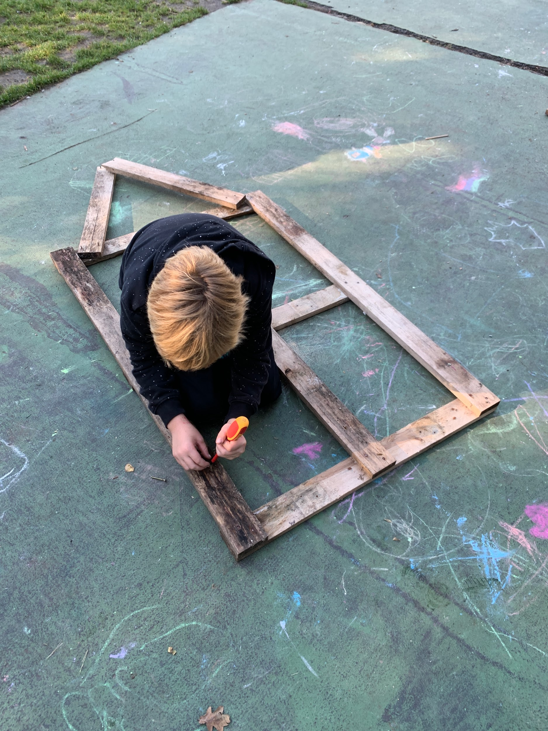
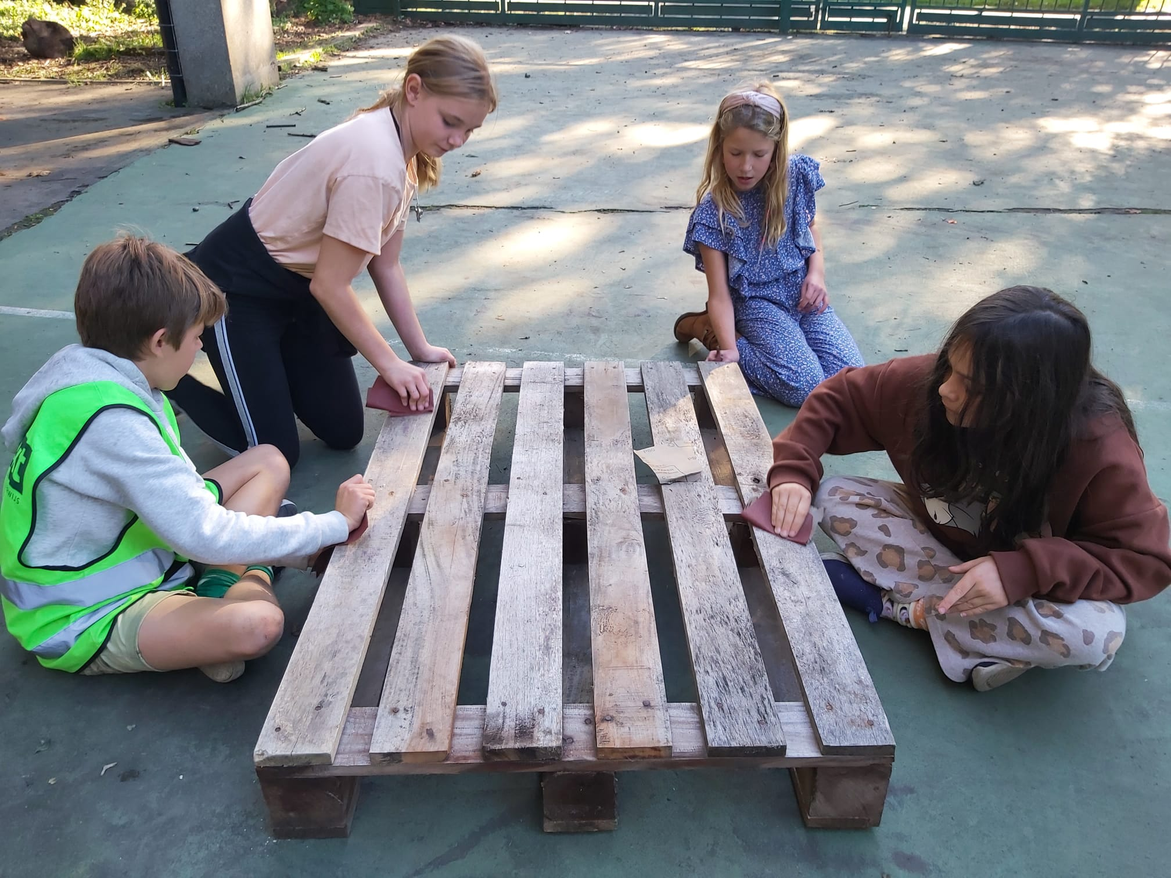
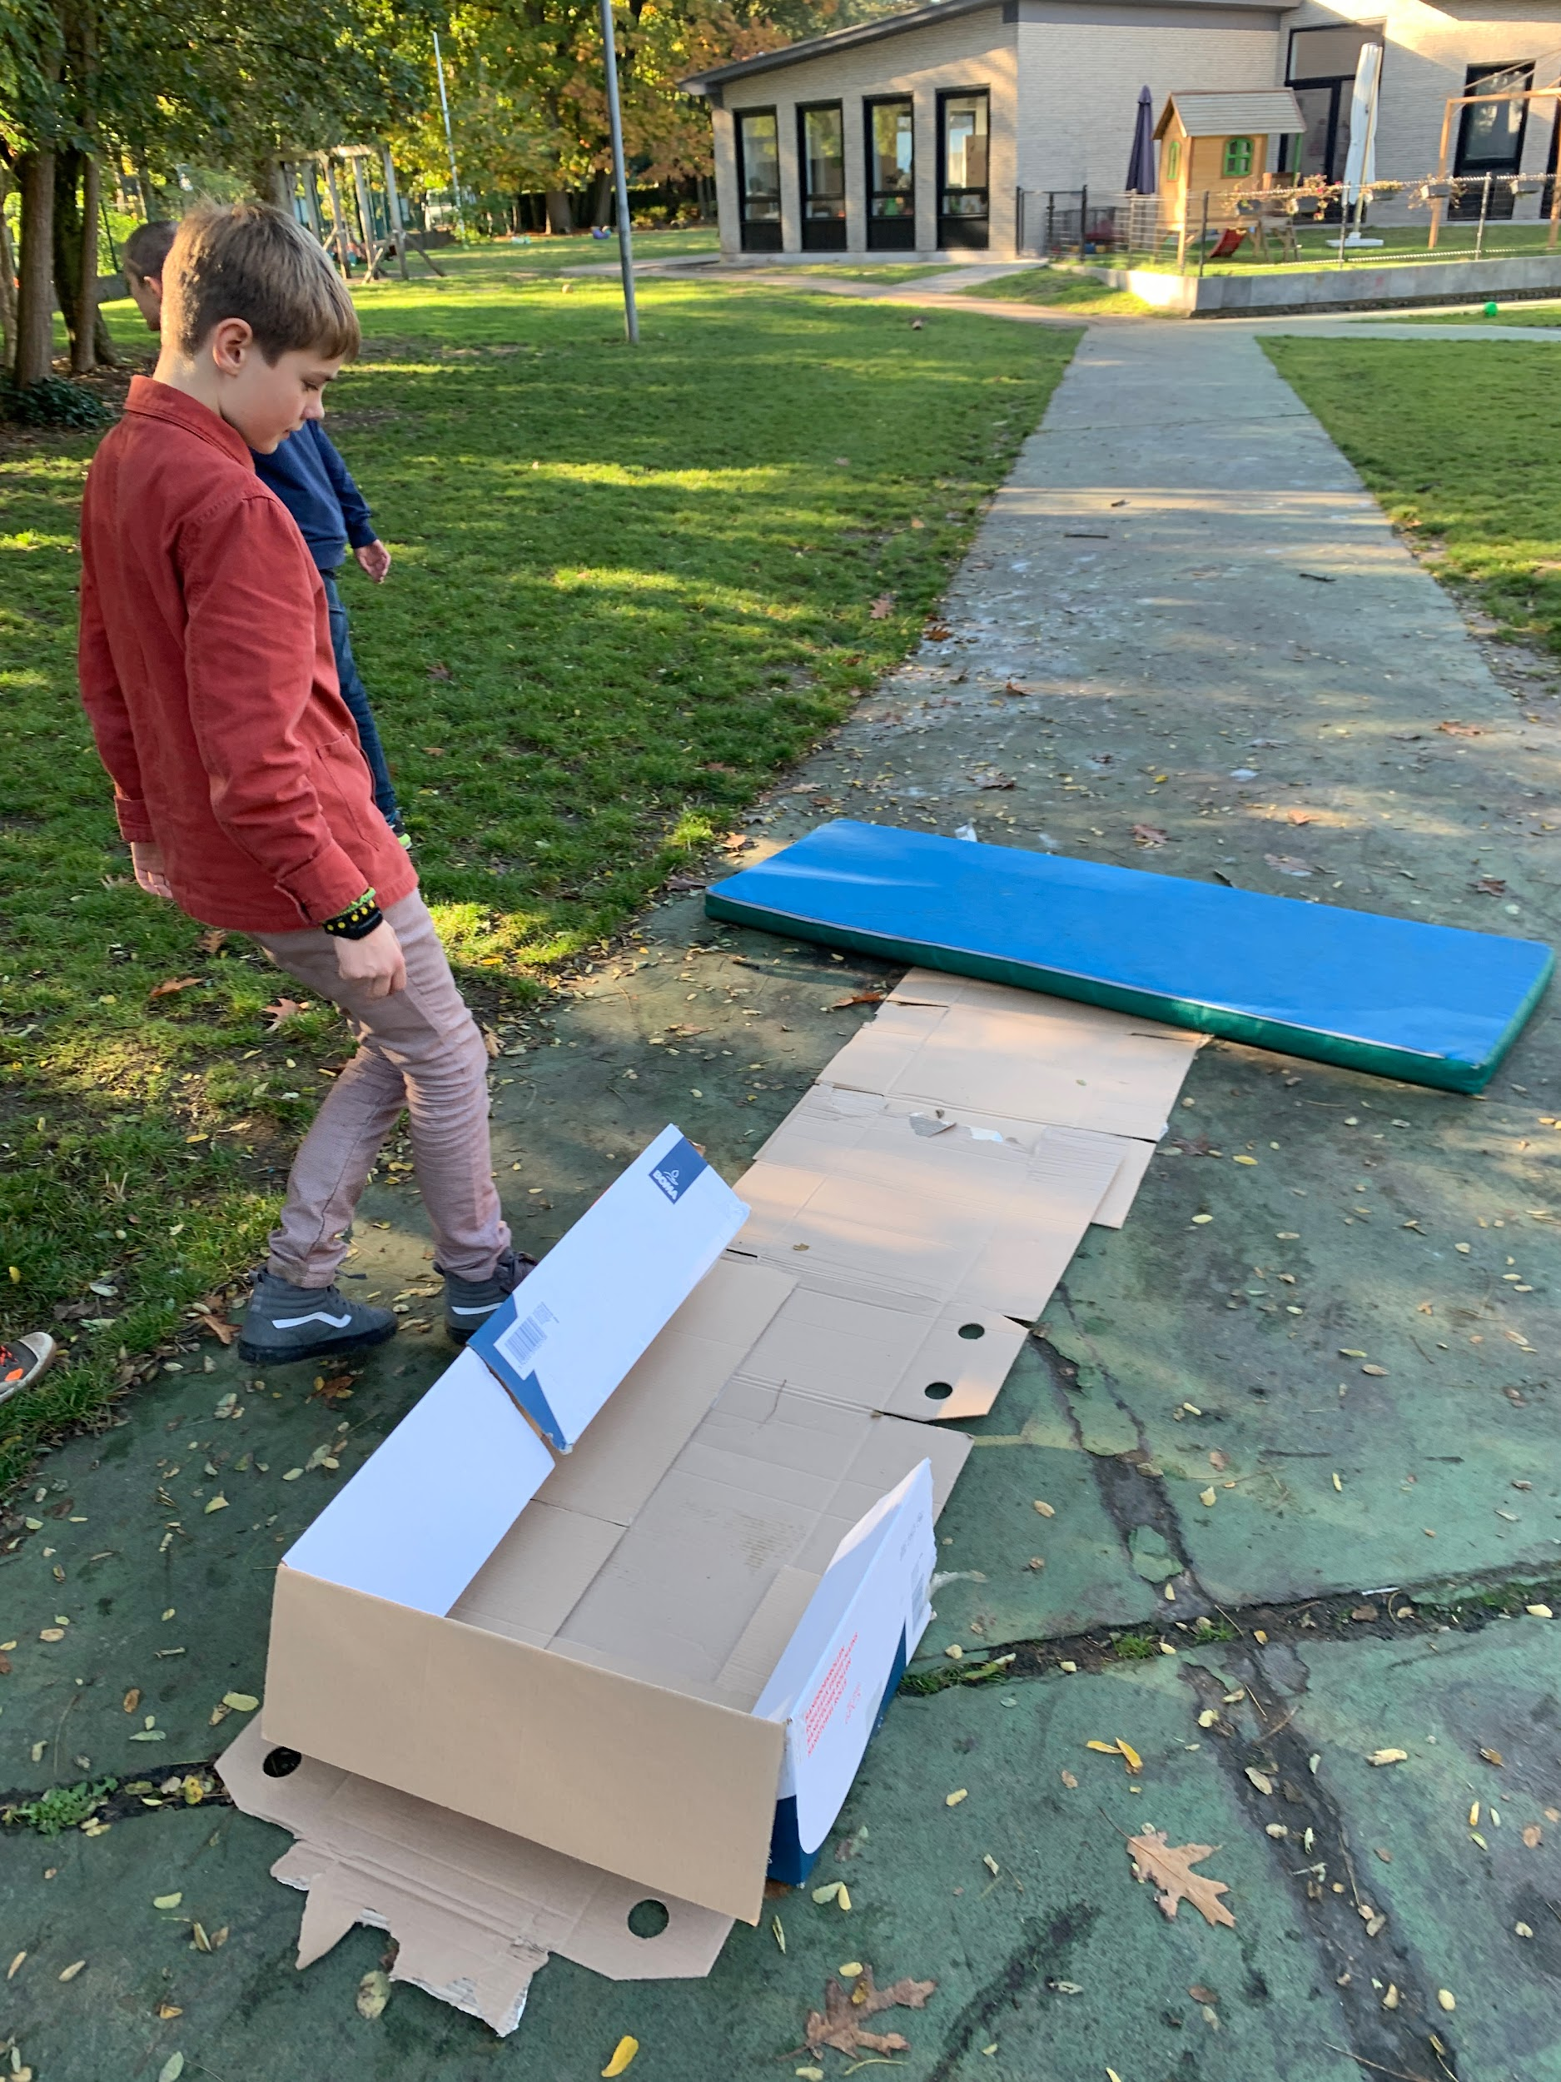
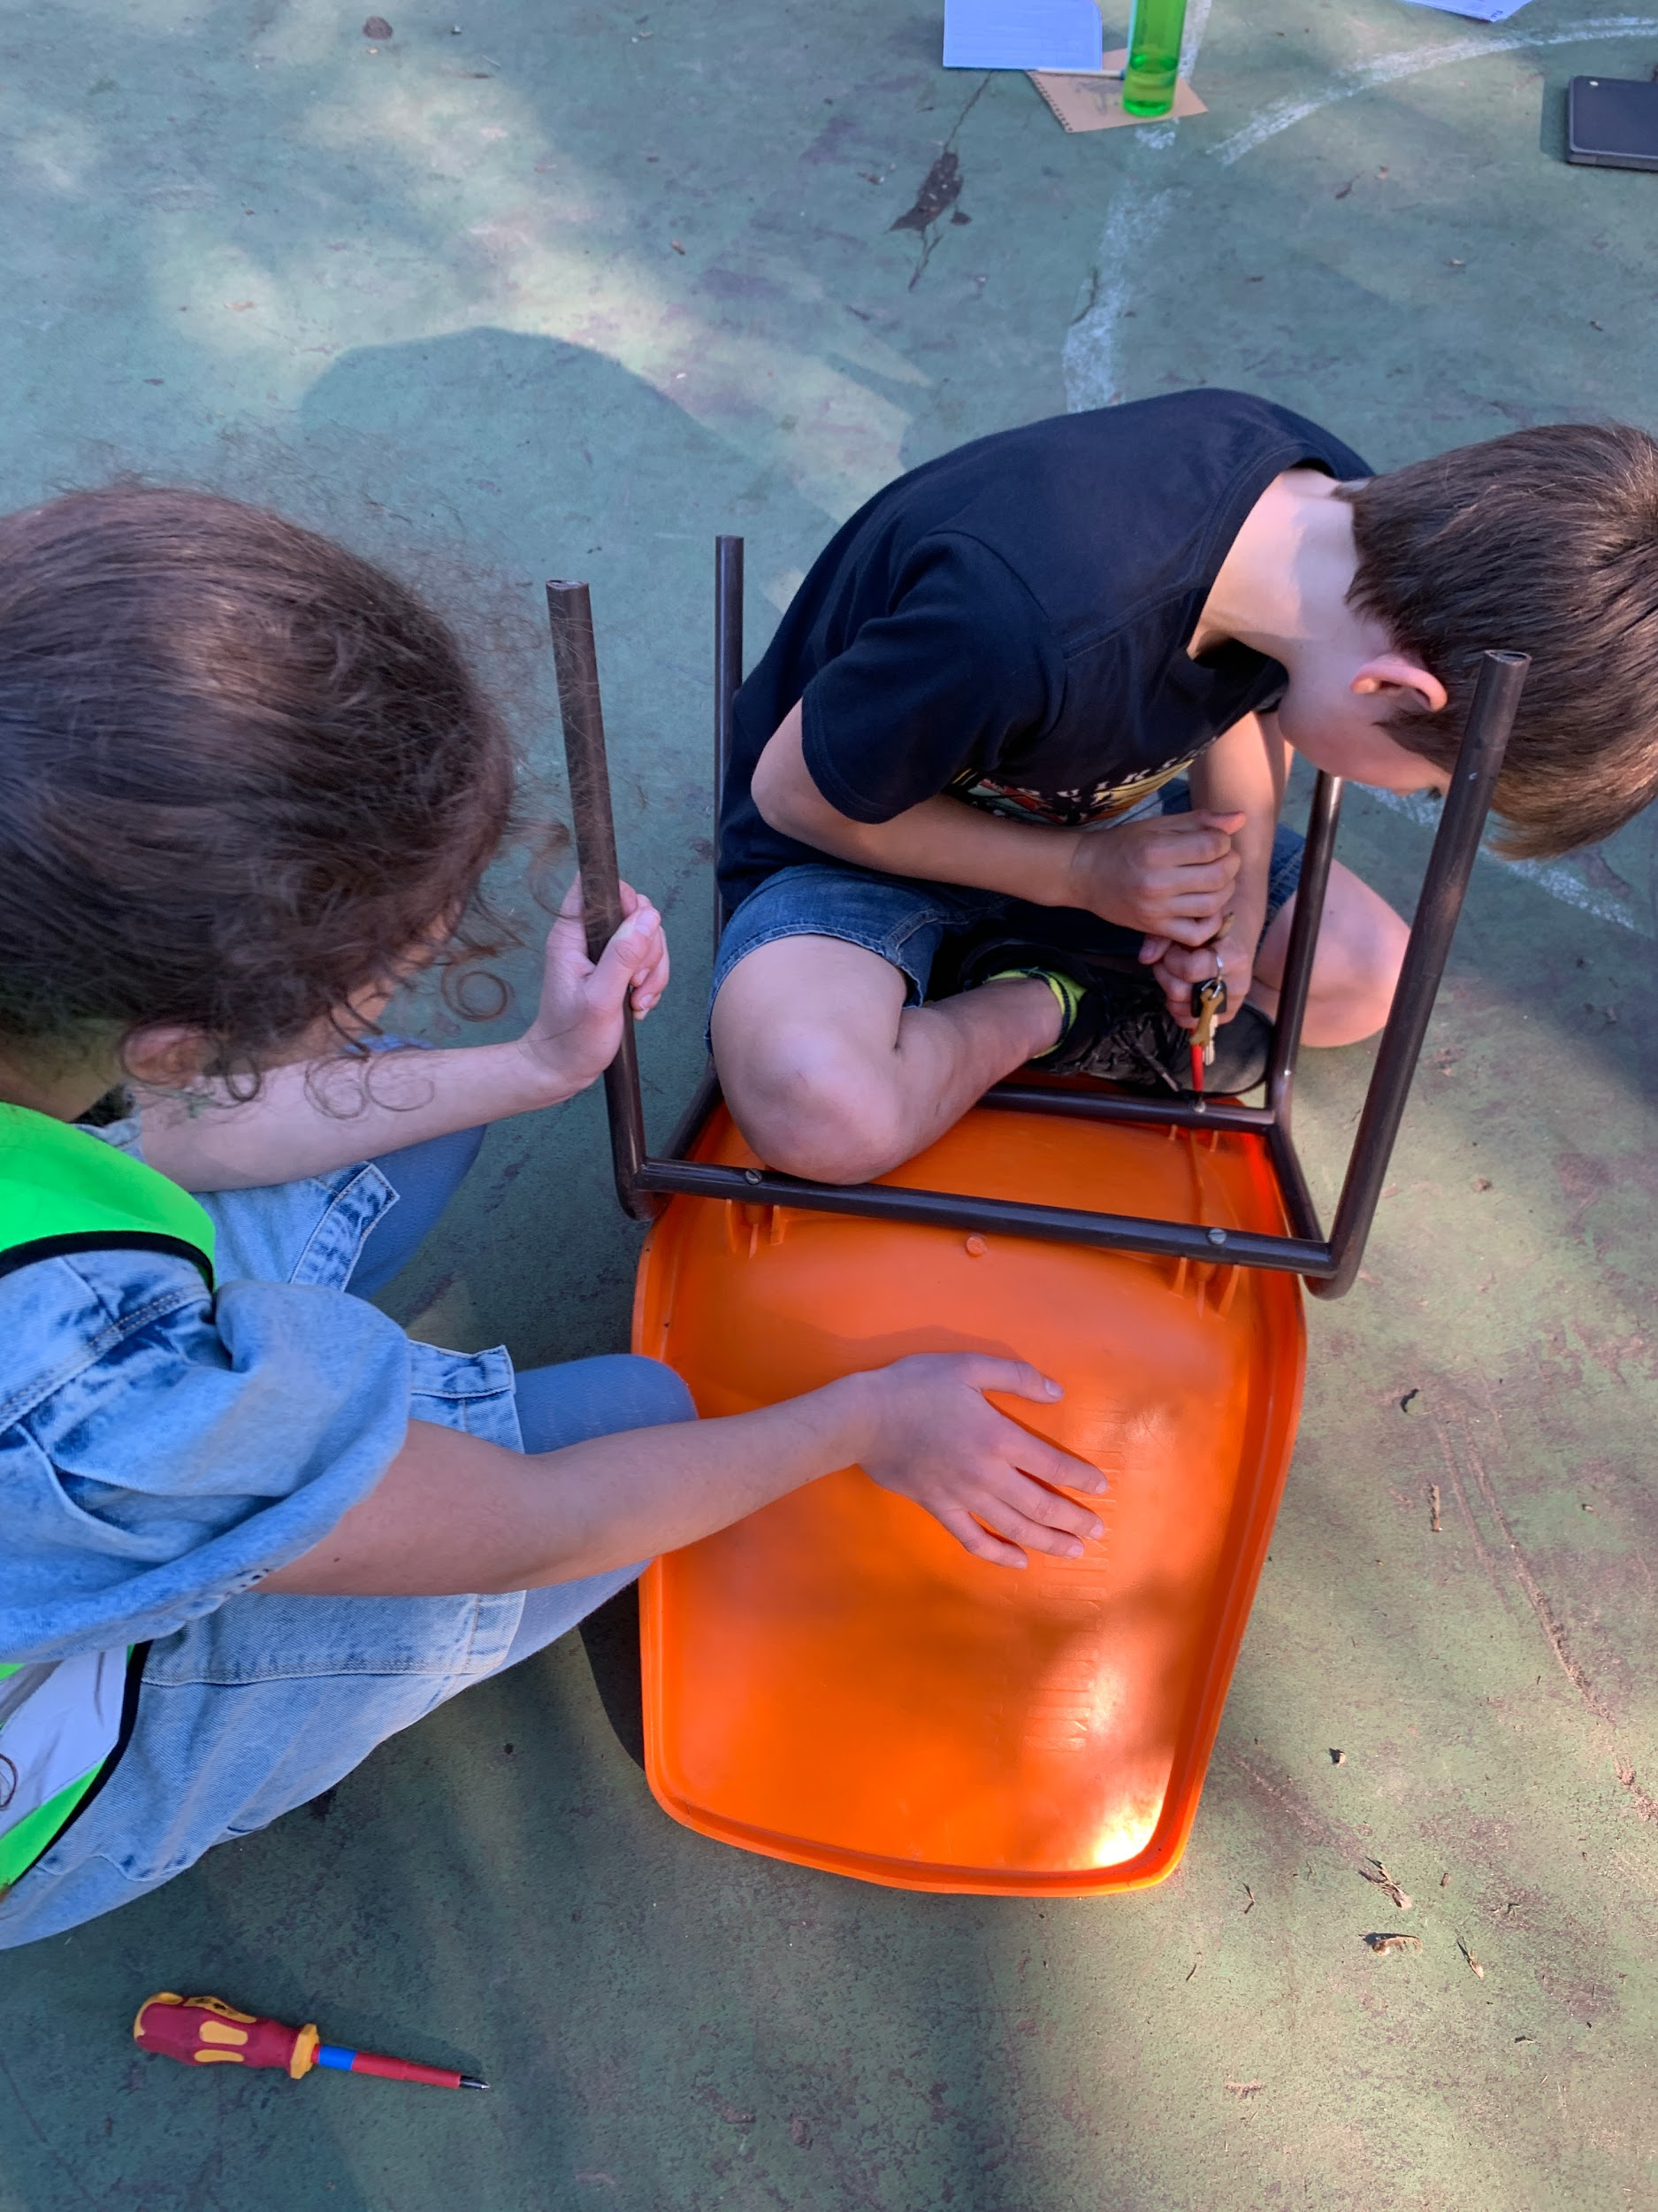
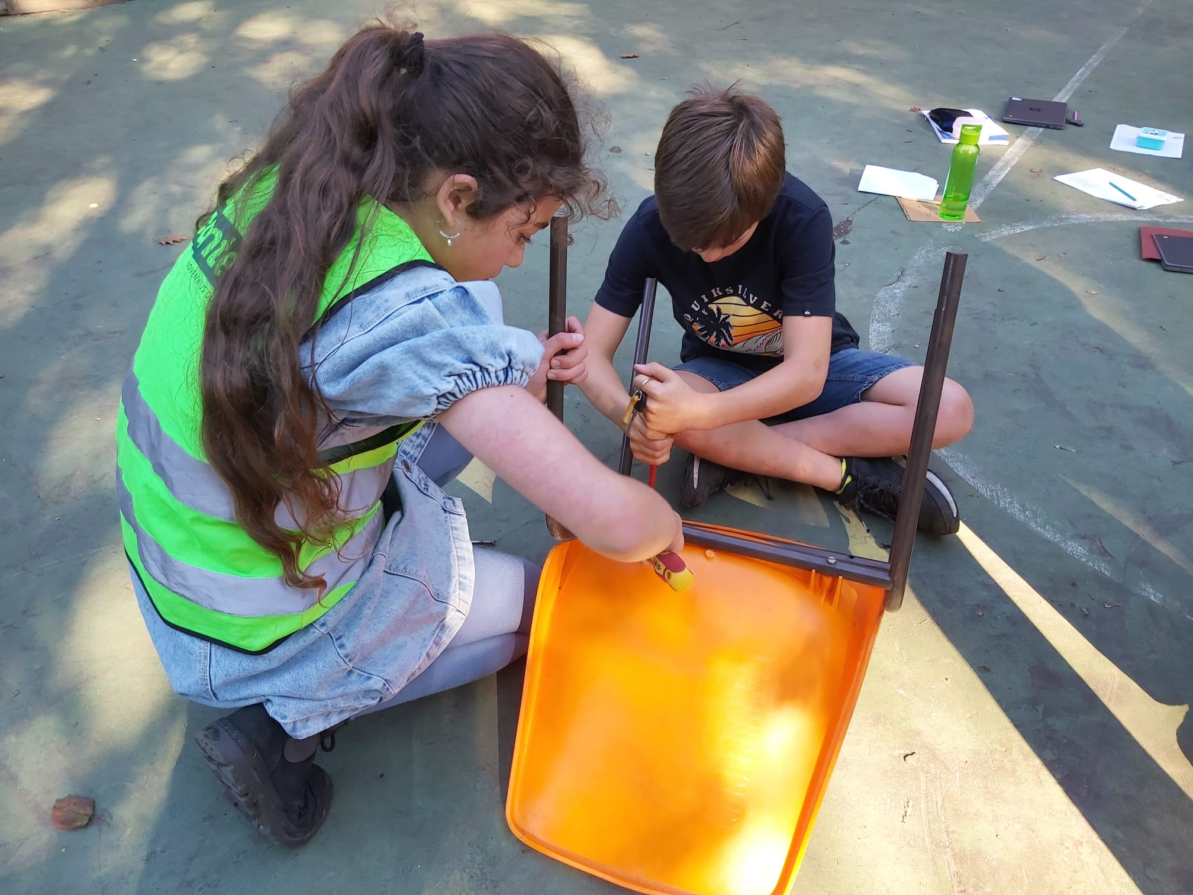

Slide 6
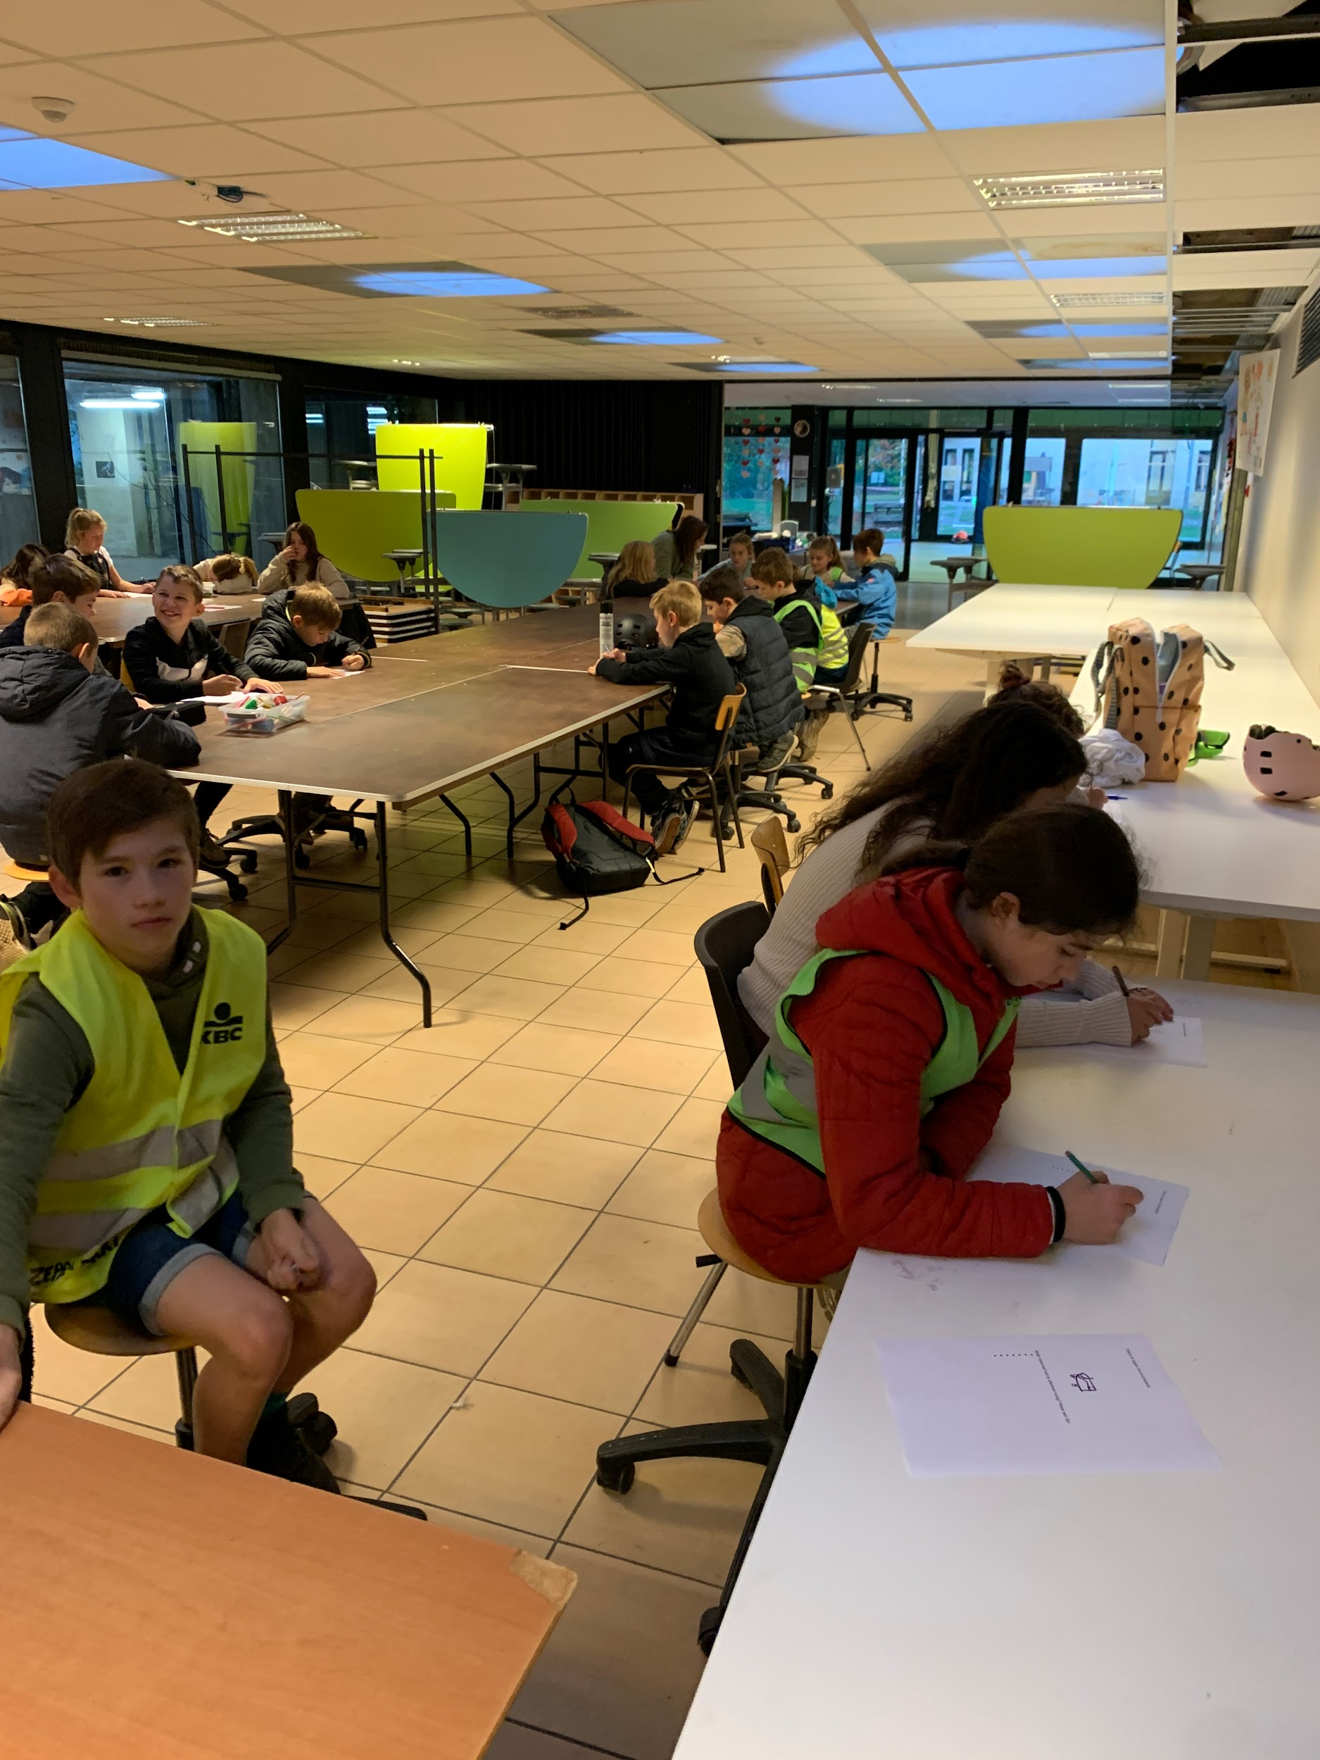
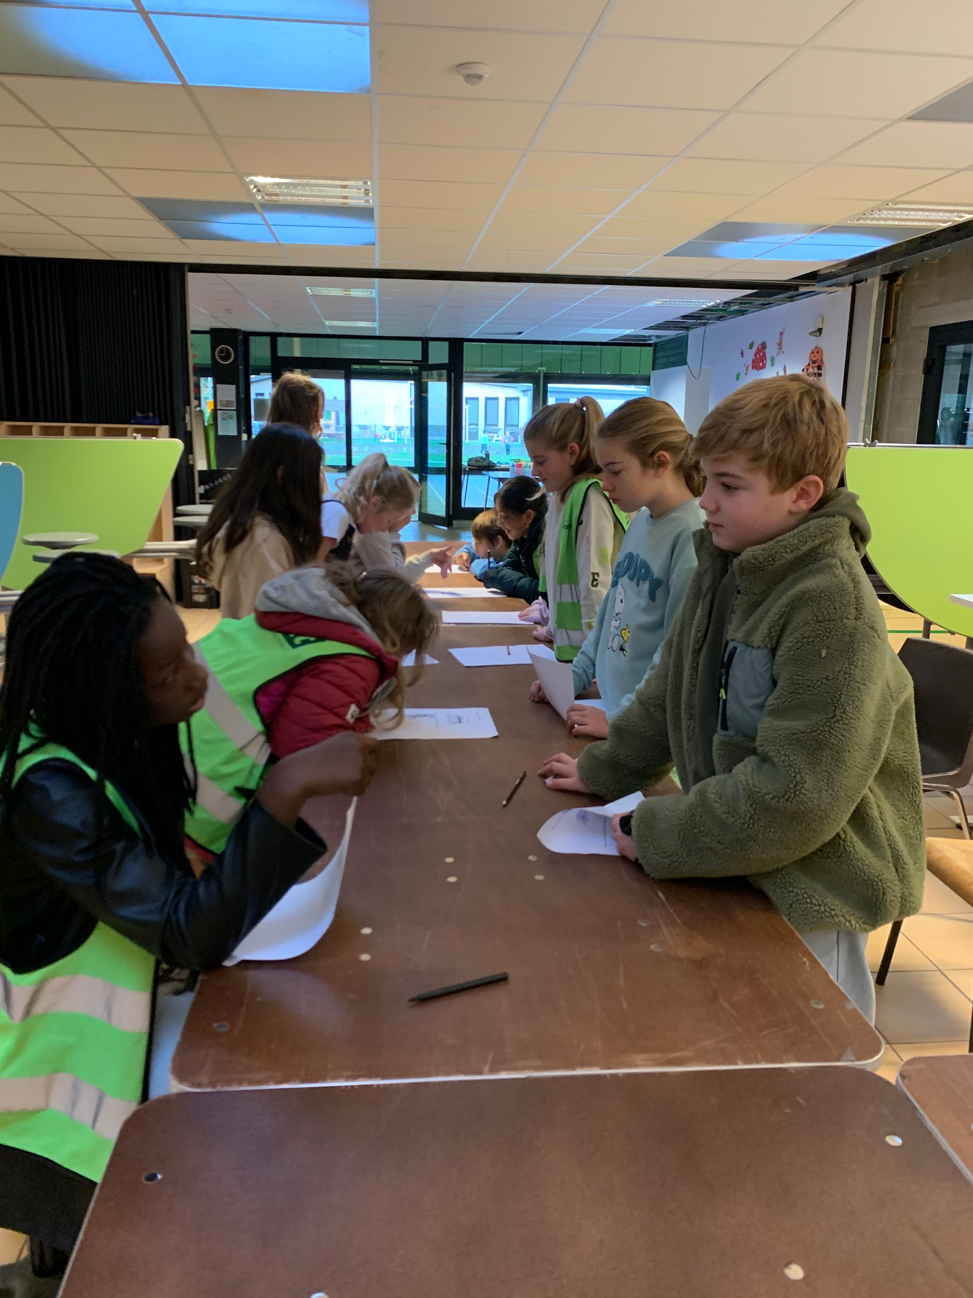

Slide 7
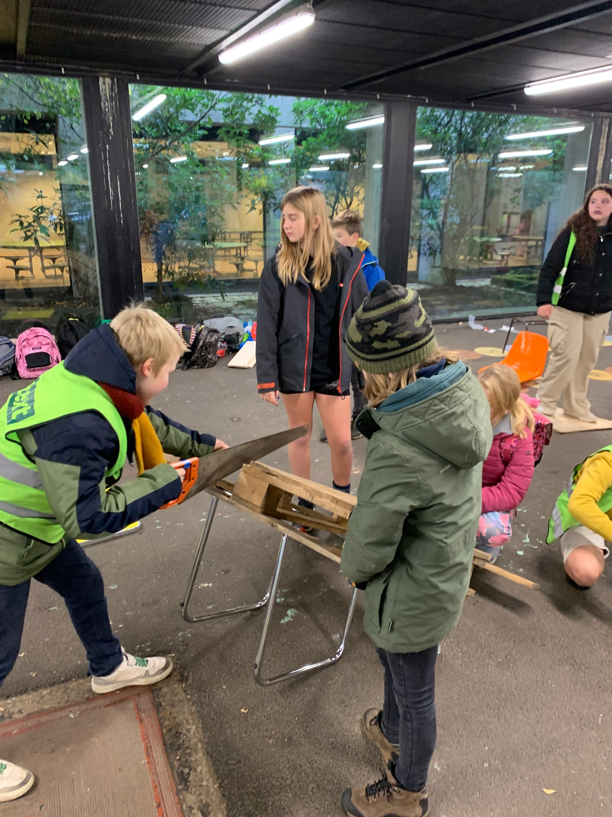
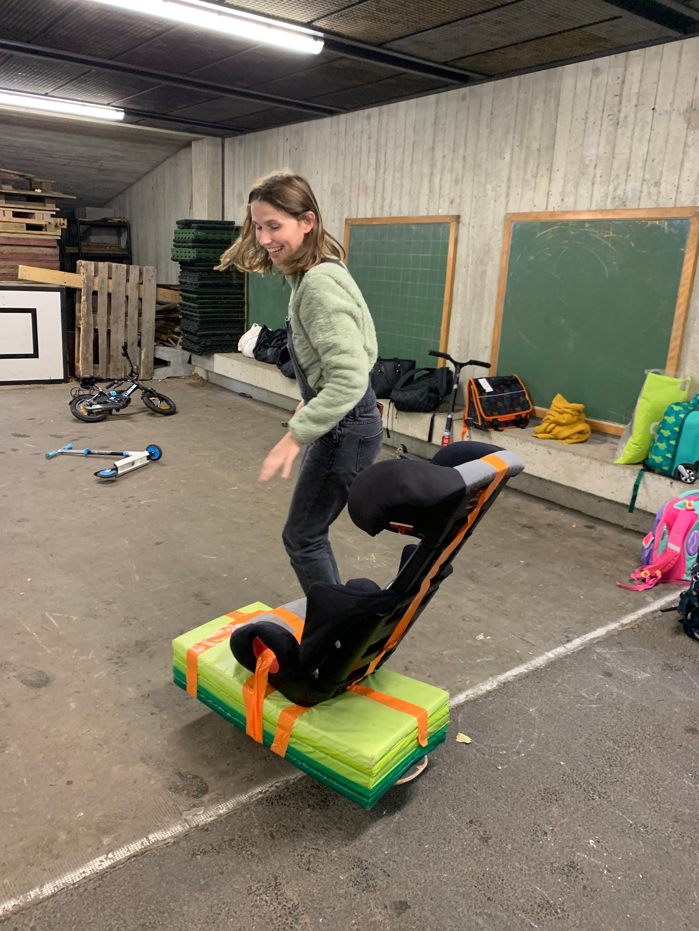

Slide 8
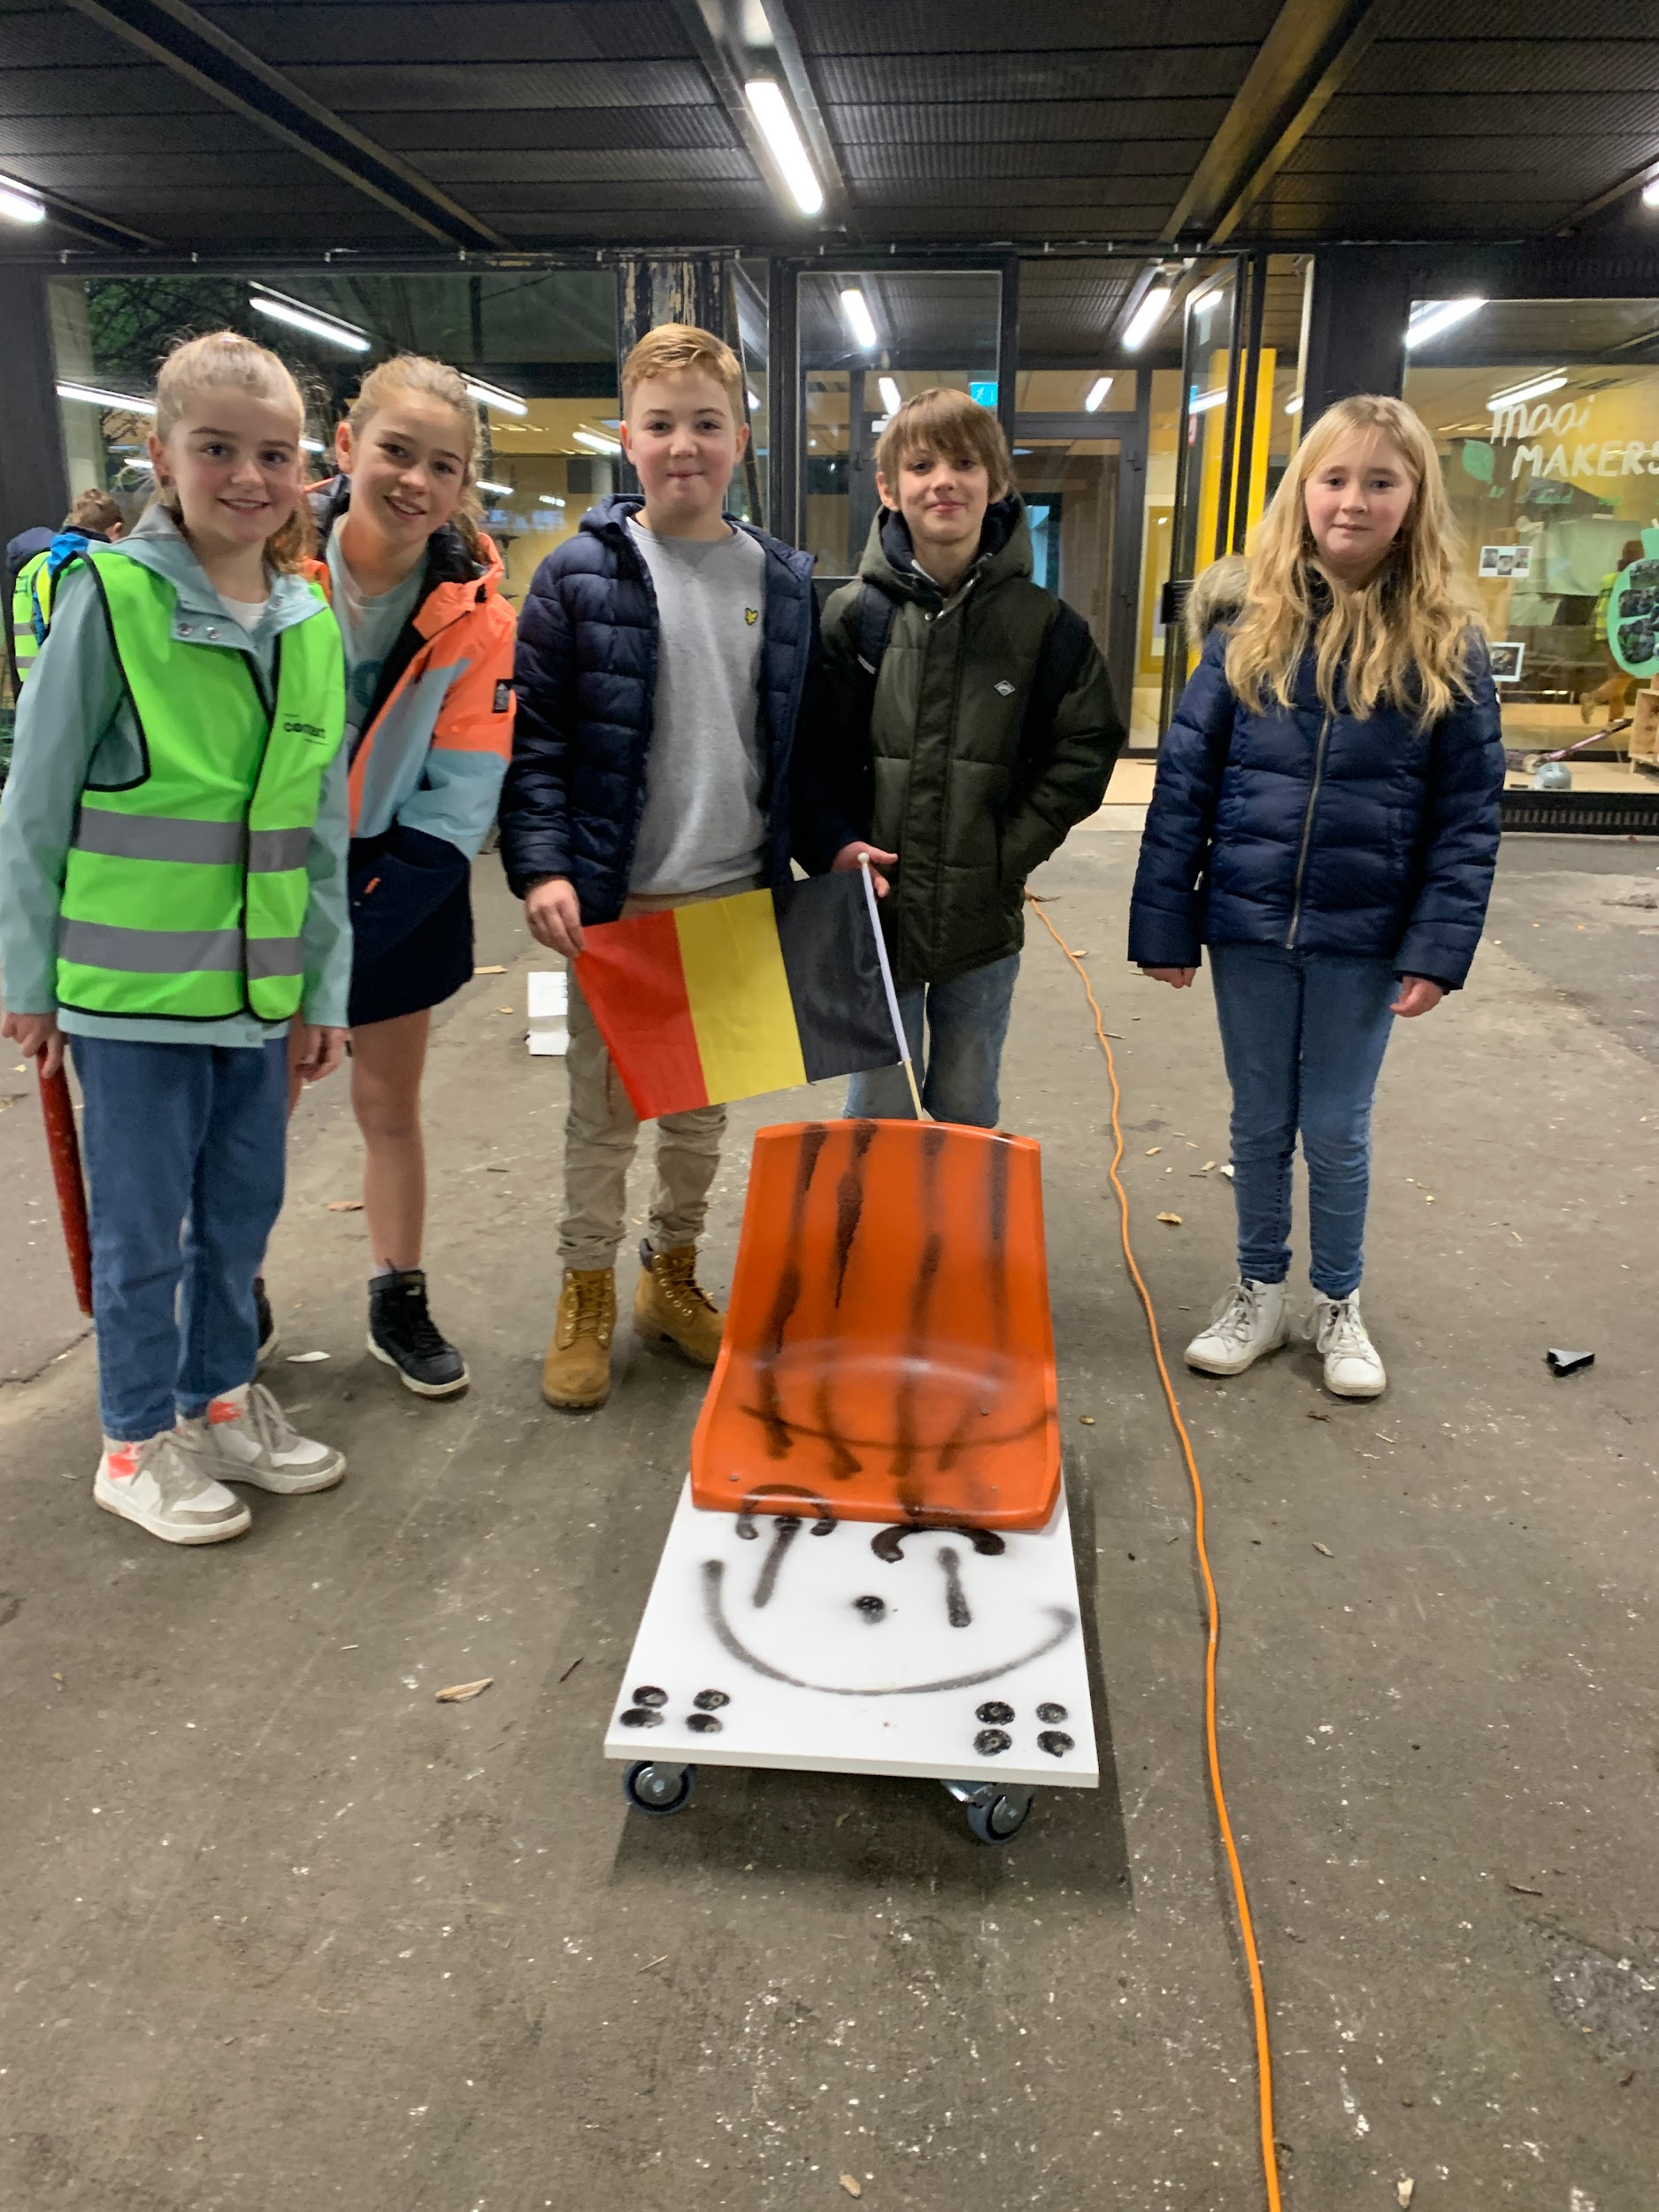
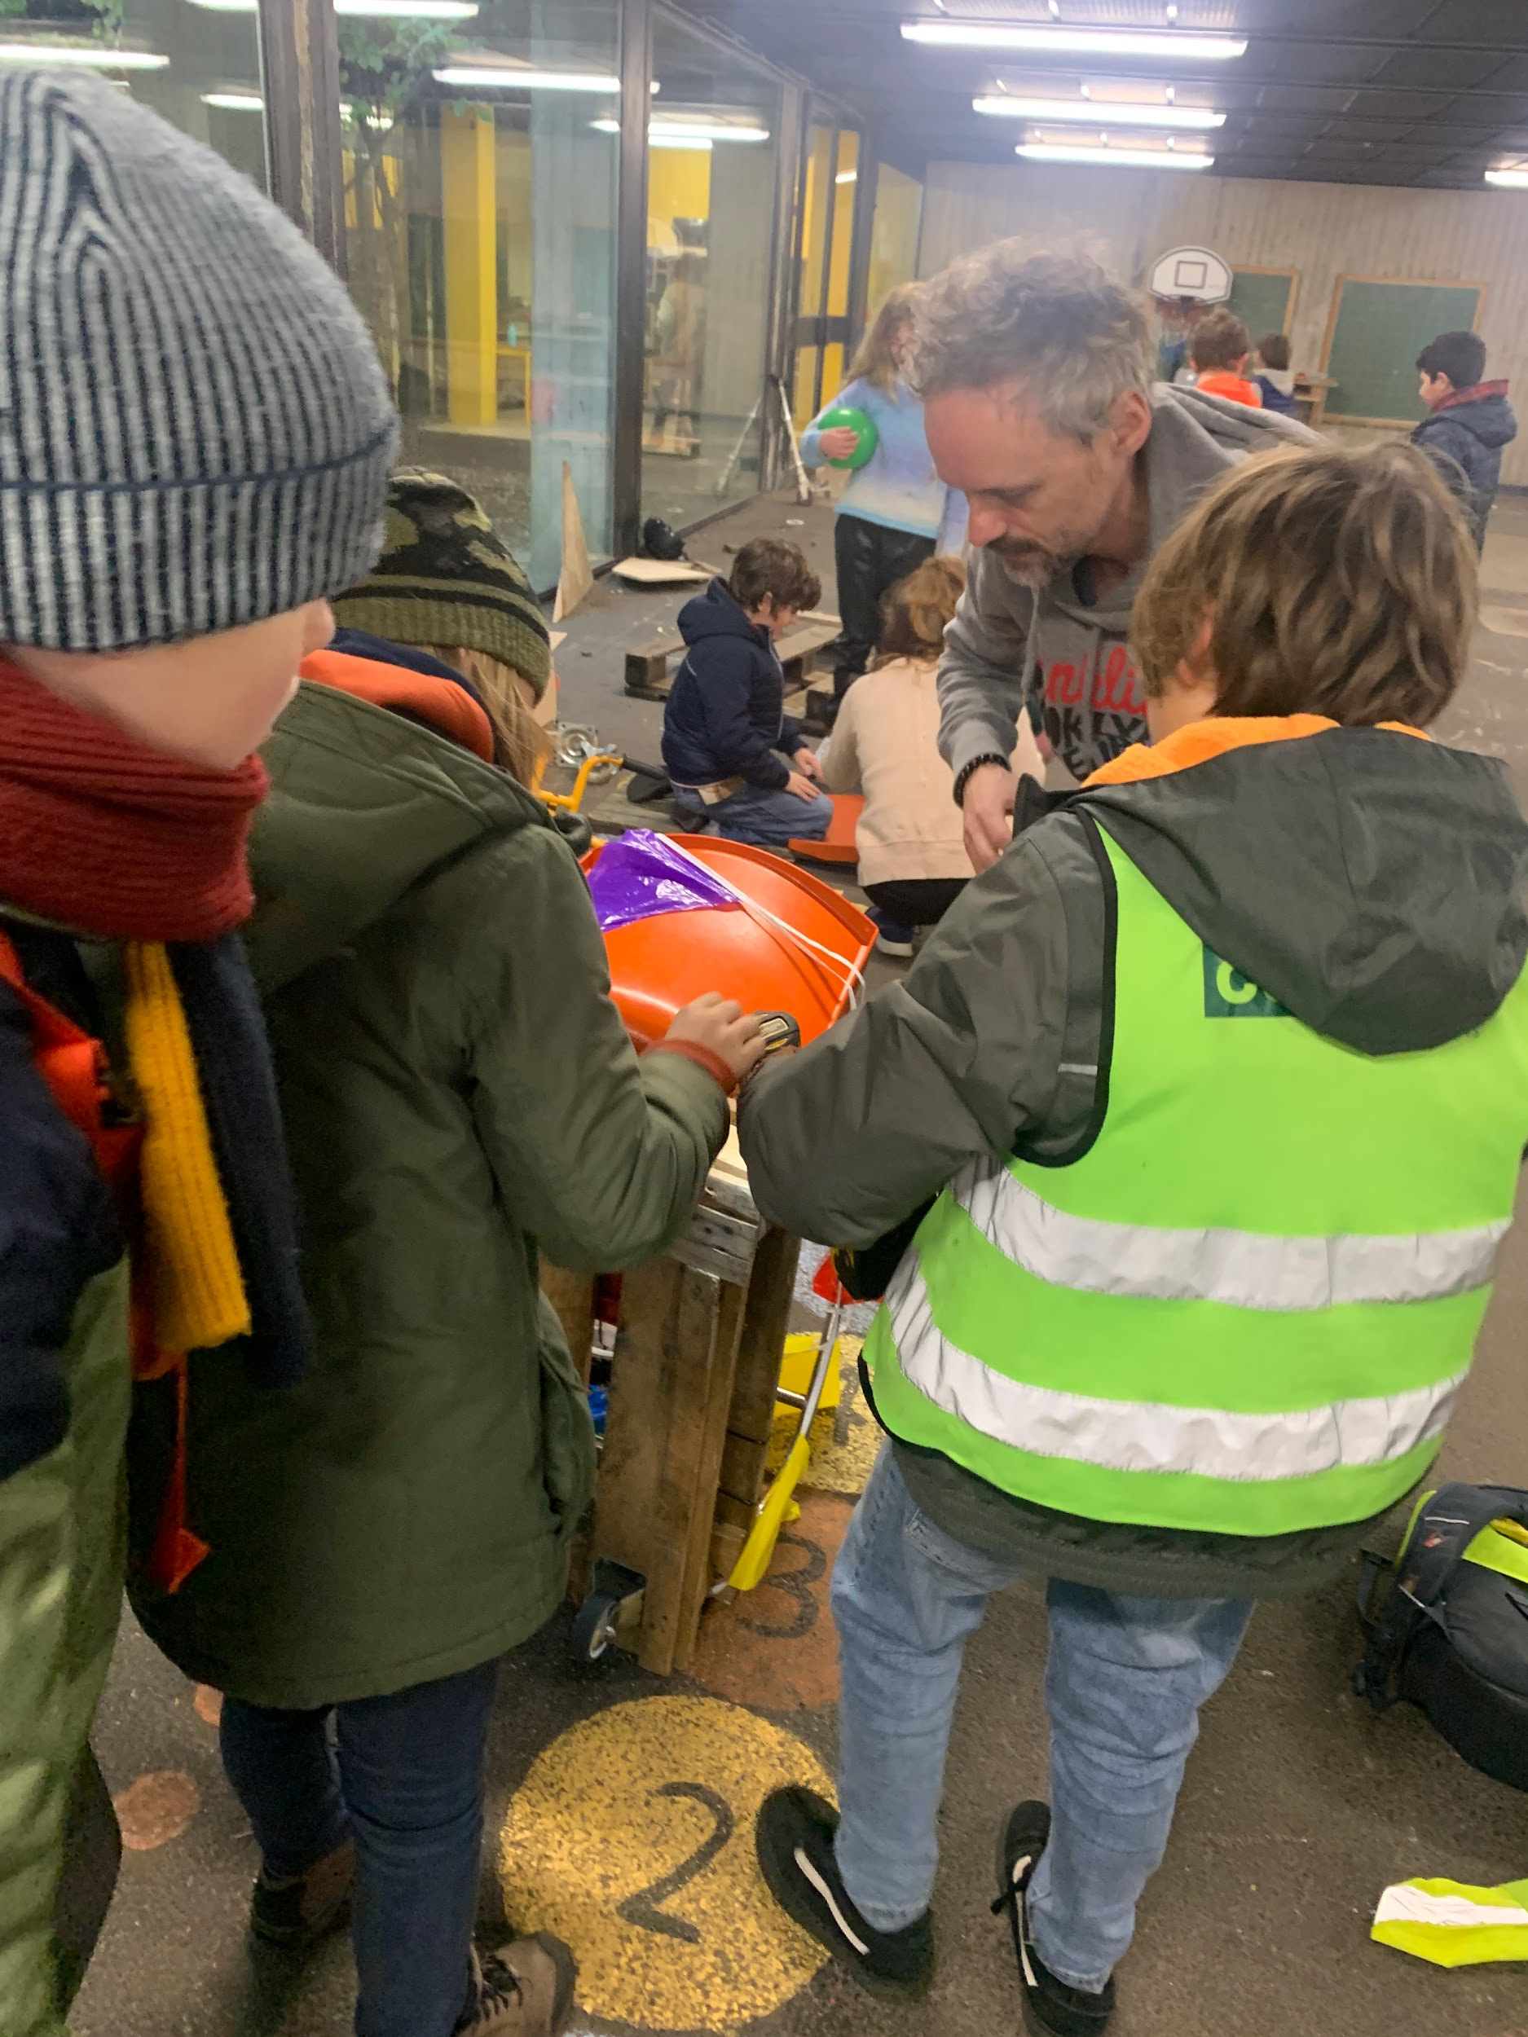

Slide 9
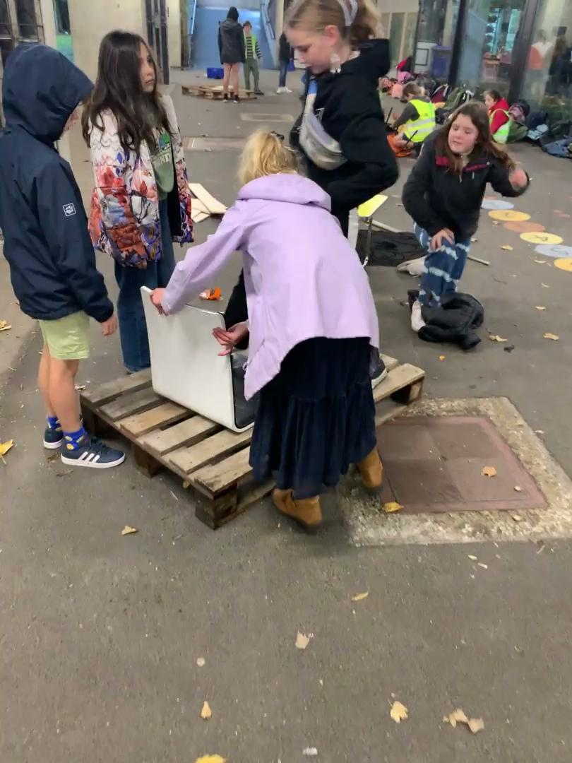

Slide 10
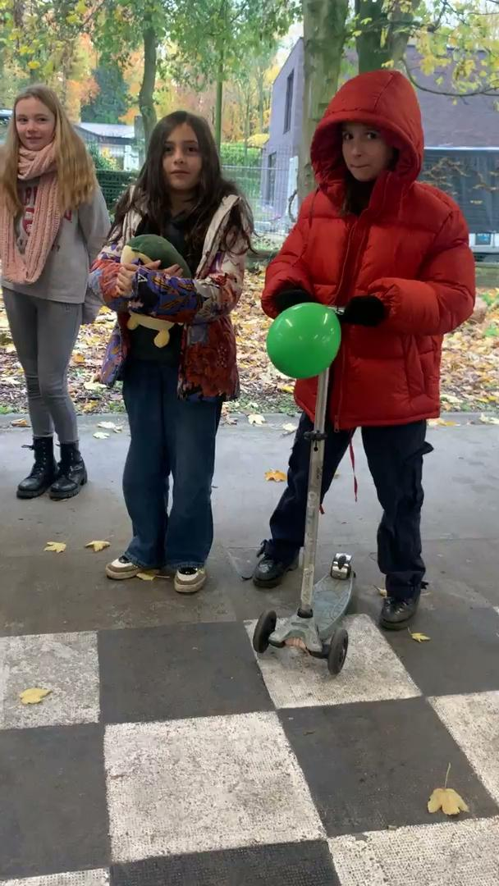

Slide 11
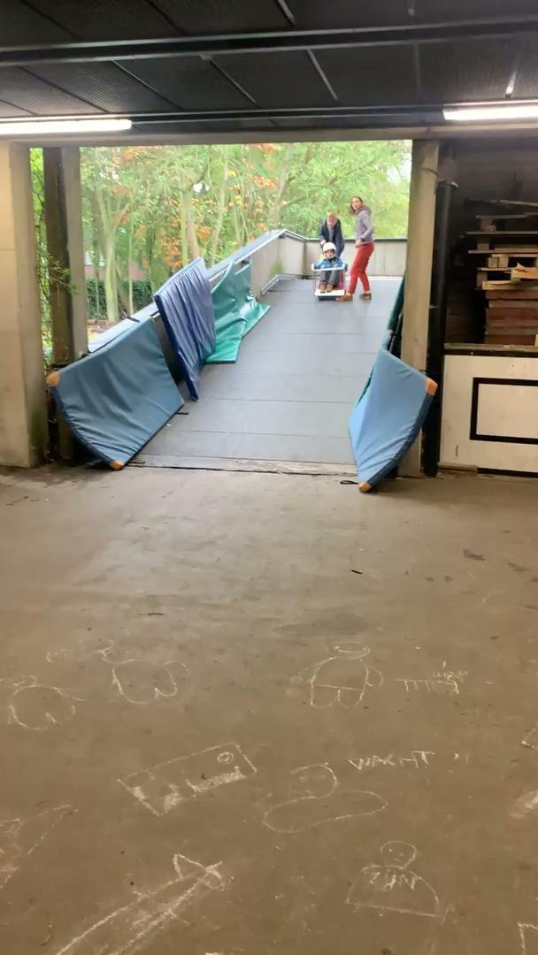

Slide 12
